Slide 1
Intro to Artificial Neural Network
https://github.com/semmi88/ML_Course

Slide 2
3 layers of abstraction
Level 1: Neuron
Level 2: Network of neurons
Level 3: Cost function
Increasing in complexity

Slide 3
3 layers of abstraction
Level 1: Neuron = simple function
Level 2: Network of neurons = composition of simple functions
Level 3: Cost function = meta-function

Slide 4
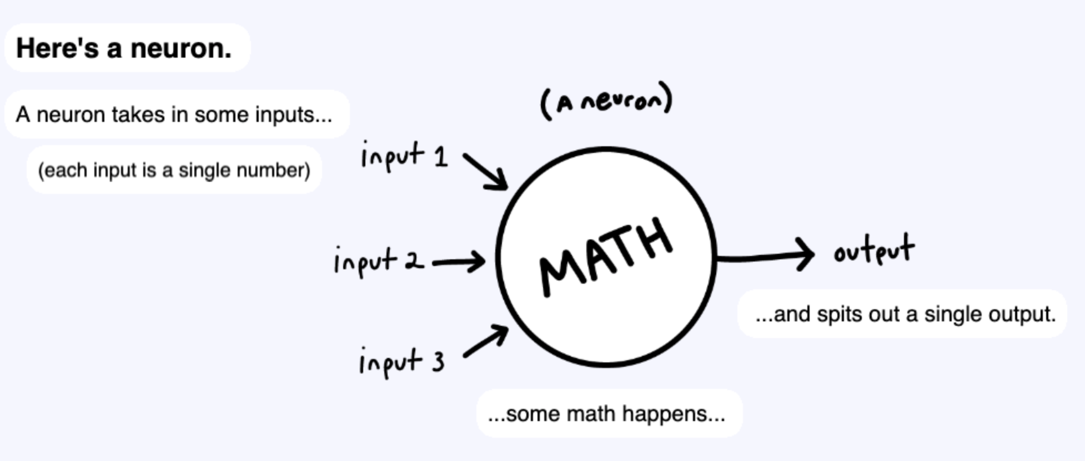

Level 1: Neuron
Neuron == Function
- many inputs
- one output
Notes:
https://aegeorge42.github.io/

Slide 5
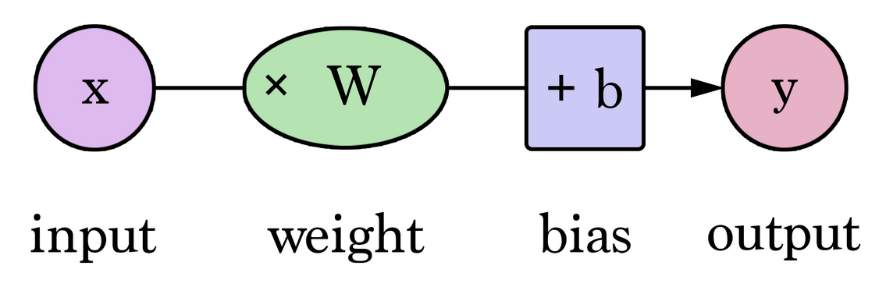
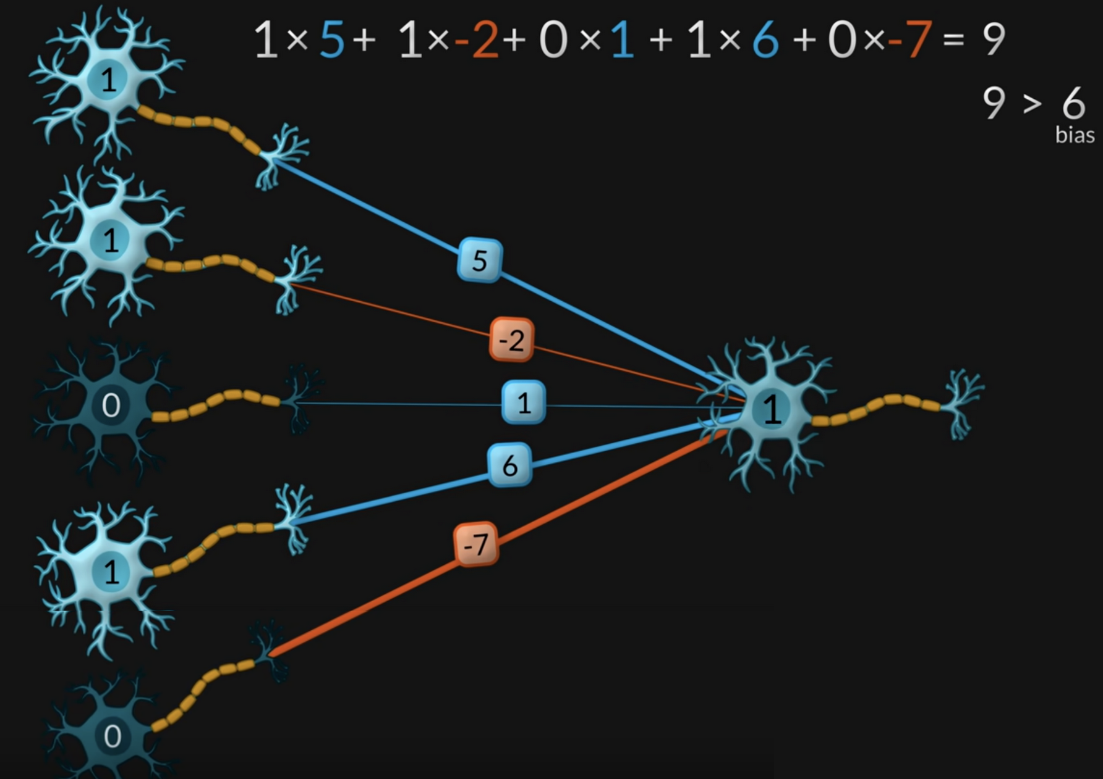

Neuron connections
- weights: determine connection strength and influence (excitatory vs inhibitory)
- bias: threshold that determines neuron output, activation level
- input - binary
- output - binary (activation)
Notes:
https://youtu.be/GVsUOuSjvcg?t=288
Bias = Küszöbérték, előfeszültség

Slide 6
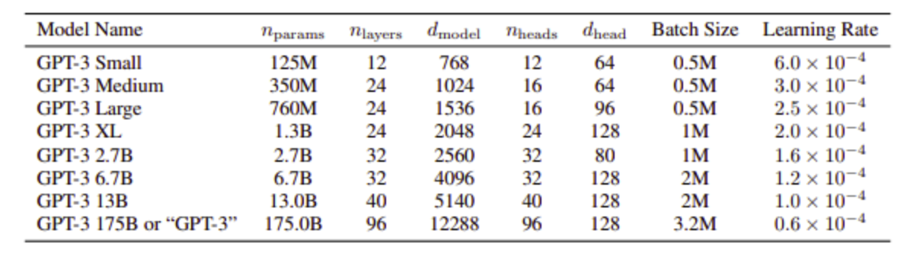
Neural network size
Total number of weights + biases in a network of neurons

Slide 7
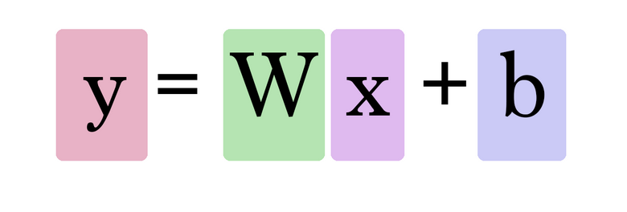
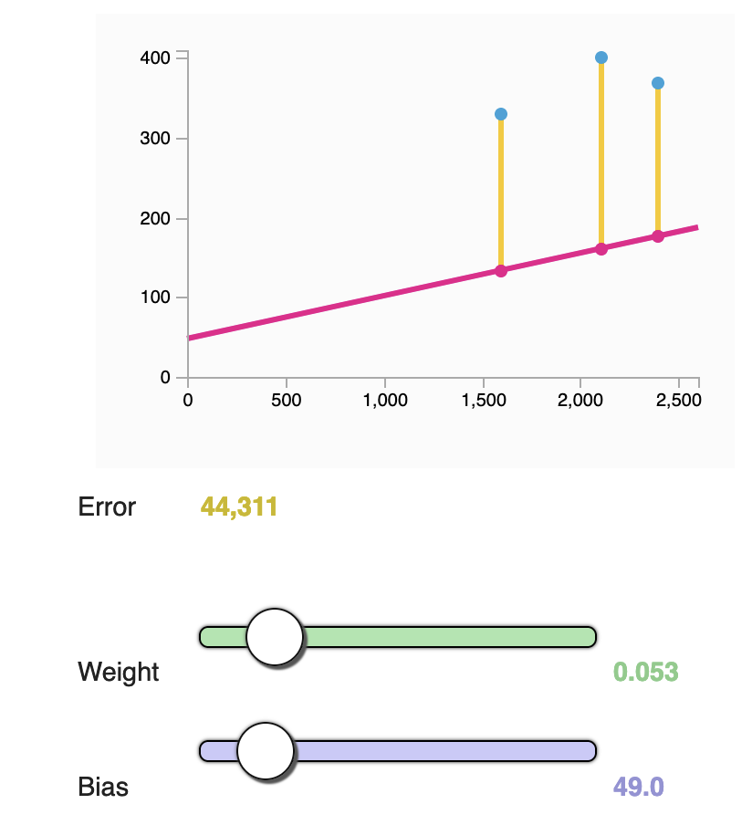
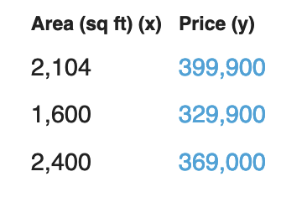
Linear Regression
- simple network, 1 input - 1 output
- fitting a straight line, that best predicts linear relationship between input & output
- minimize error (using available data)

Slide 8
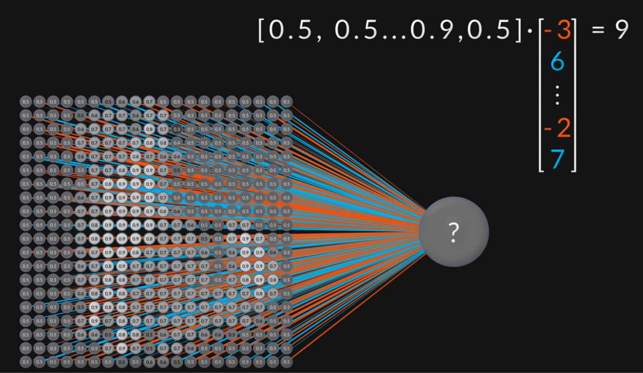

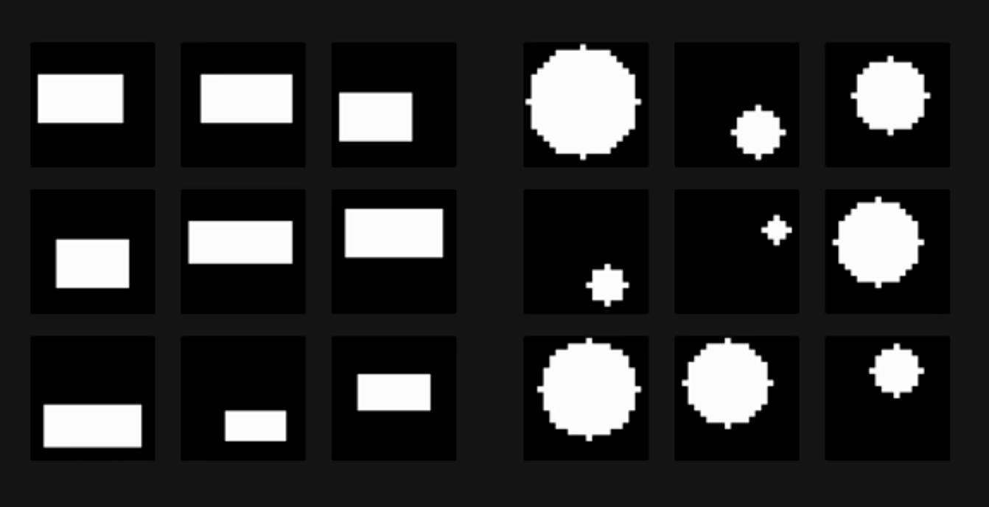
Perceptron
1958 - Cornell University, USA
- 20x20 pixel image input
- single layer
- output: 0: rectangle 1: circle
Notes:
https://youtu.be/GVsUOuSjvcg?t=288

Slide 9
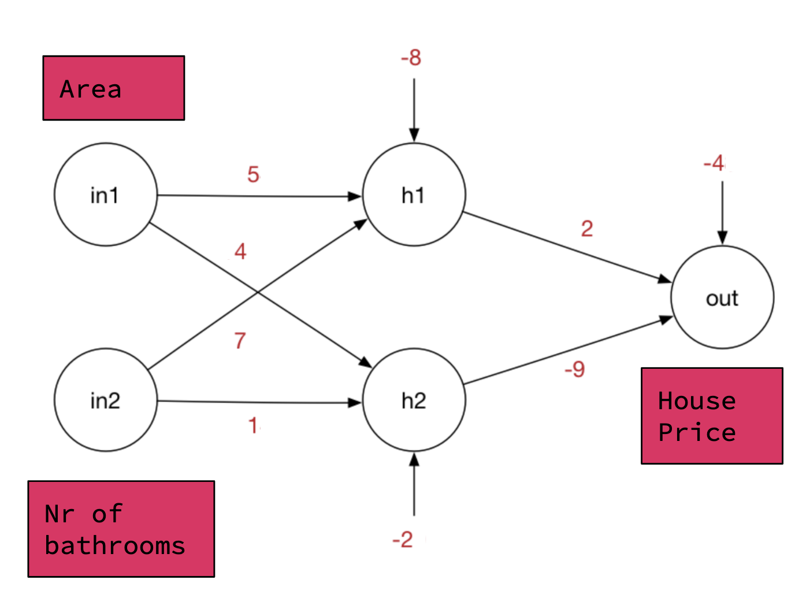
Level 2: Network
Multi-Layer Network
adding intermediate neurons in the middle
- inputs (2) - output (1) - parameters (9) - weights - strength of connection - biases - threshold, tendency to be active
What is the benefit?

Slide 10
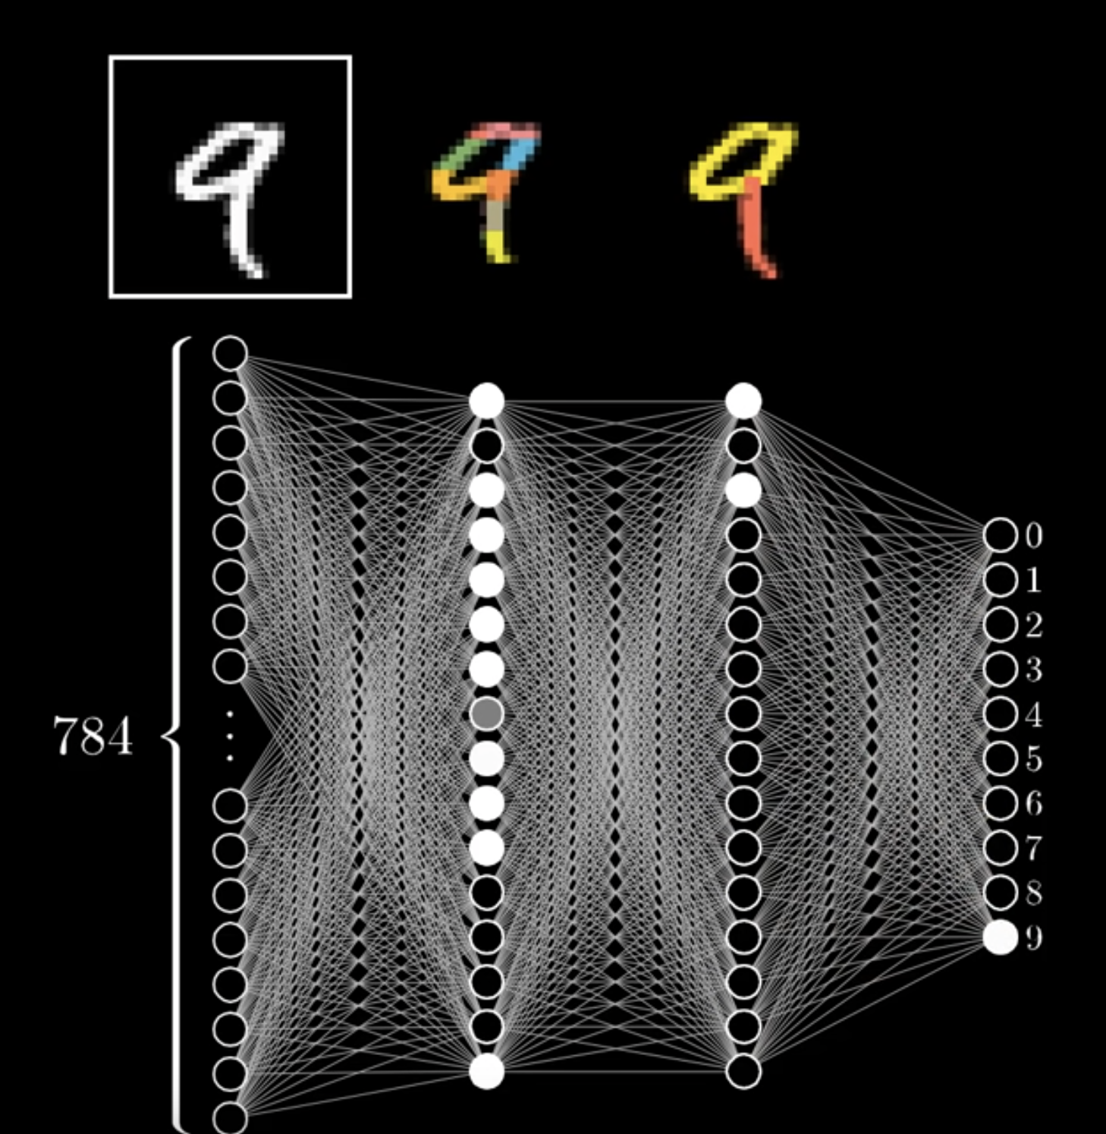
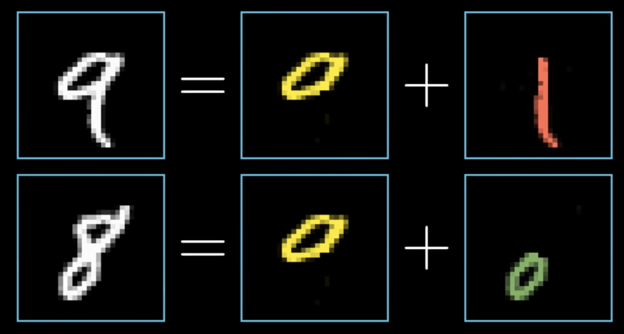
Multiple layers
What is the benefit?
- intuition/expectation - breakdown problem into components
- layered structure allows for increasingly complex operations
Notes:
https://youtu.be/aircAruvnKk?list=PLZHQObOWTQDNU6R1_67000Dx_ZCJB-3pi&t=460

Slide 11
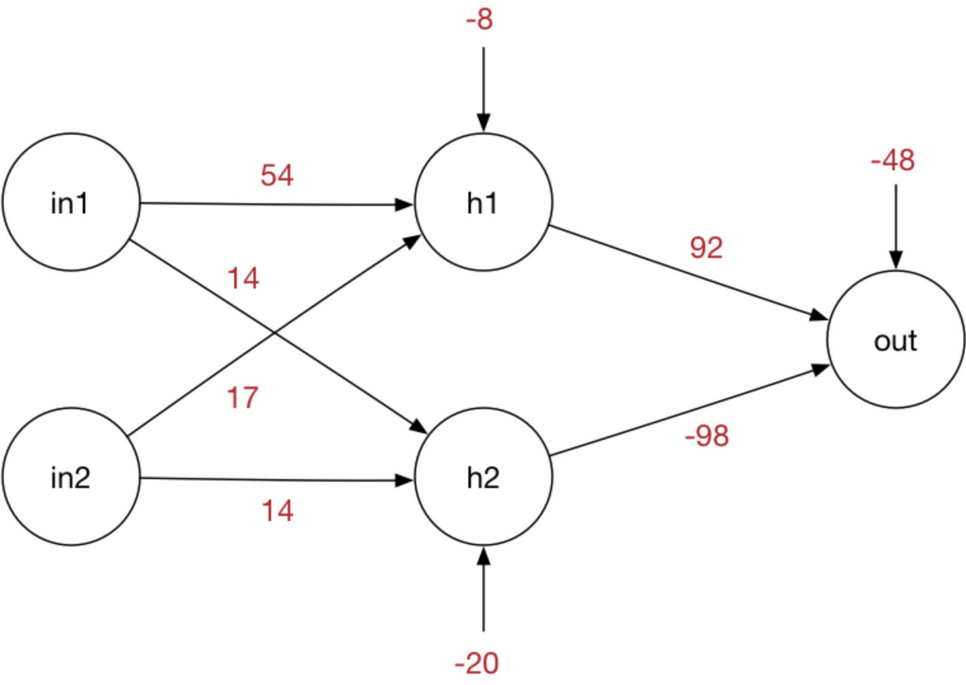

Linearity
out = w * in + b
a linear combination of a linear combination is still a linear combination
out = 2 * (5 * in1 - 8) - 4
out = 10 * in1 - 16 - 4 = 10 * in1 - 20
Area
House Price
Nr of bathrooms

Slide 12

Linearity
out = w * in + b
10
a linear combination of a linear combination is still a linear combination
out = 2 * (5 * in1 - 8) - 4
out = 10 * in1 - 16 - 4 = 10 * in1 - 20
Area
-20
House Price
Nr of bathrooms

Slide 13
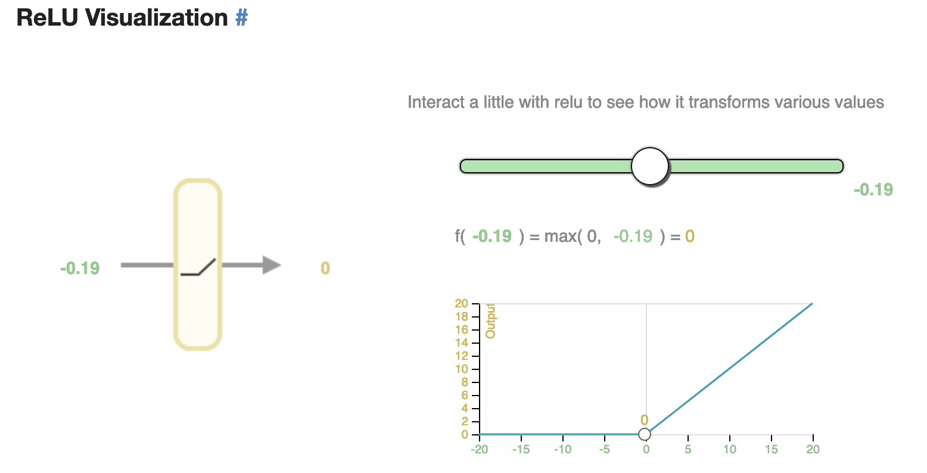

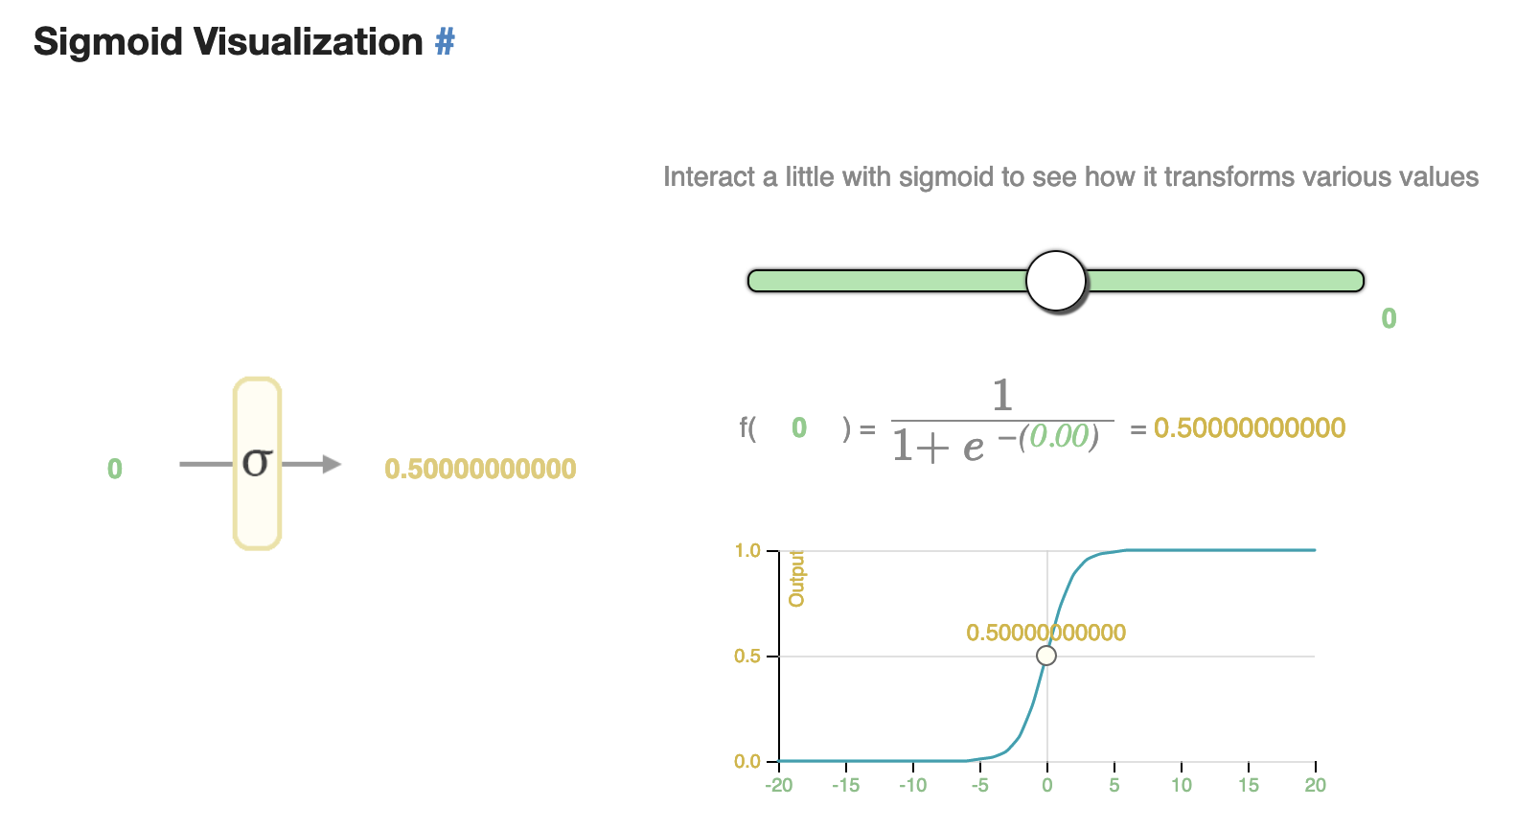
Activation functions
- provide non-linearity, which help neural networks perform more complex tasks
- neural networks can model any given function approximately by having appropriate parameters (weights and biases)
- UAT - Universal Approximation Theorem (video proof intuition)
Notes:
https://jalammar.github.io/feedforward-neural-networks-visual-interactive/

Slide 14
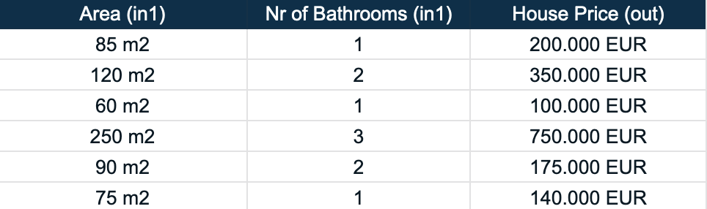
Machine learning?
- What does learning mean? Finding the best values for the weights and biases
- How can we know if some values of w&b are better than other values? Based on prediction errors - We need a labeled dataset, where we know what is the correct/expected output, and we can compare this to our predicted output

Slide 15
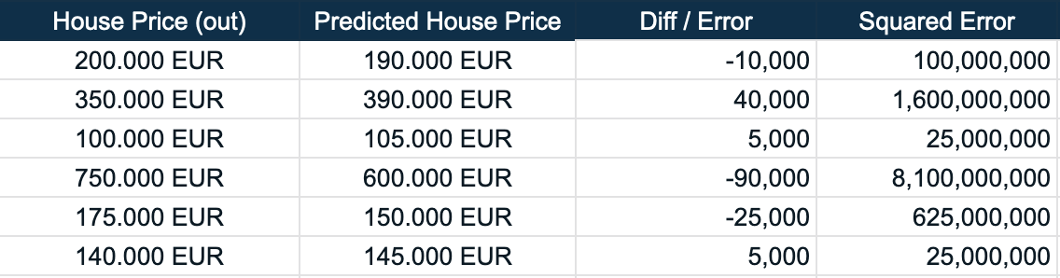
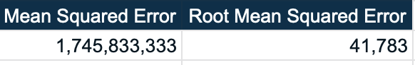
Prediction error
- difference between predicted output and correct/true output
- diff can be positive or negative - we need to square (SE) or take absolute value (AE)
- diff varies based on the example, so to be able to globally measure the error - we need to average (MSE)
- to have a smaller average value, we can take the square root of the average (RMSE)

Slide 16
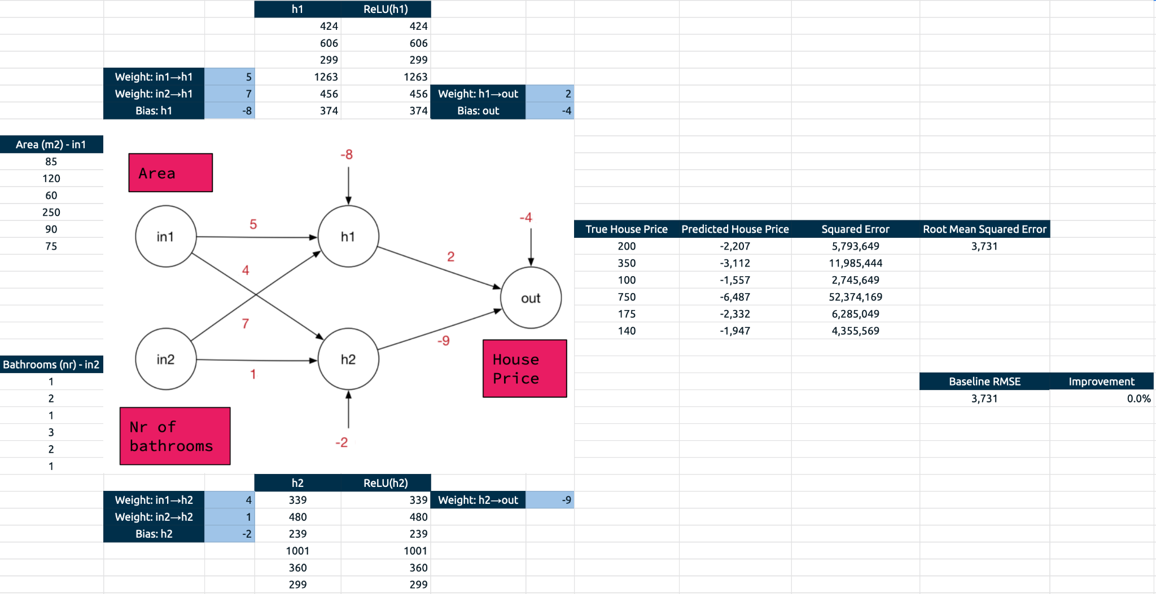
Manual Machine Learning

Slide 17
Level 3: Cost function
- measure how bad/good is the performance of the neural network across all training examples (RMSE)
Cost function == Parameterized Function
- inputs (w&b of the network) - output (1 number - the error/cost) - parameters: training examples

Slide 18
Machine Learning == Minimizing Cost Function
- changing the weights and biases - changes the output of the cost function
- how do we need to change the w&b - in order to minimize the cost? minimize RMSE?

Slide 19
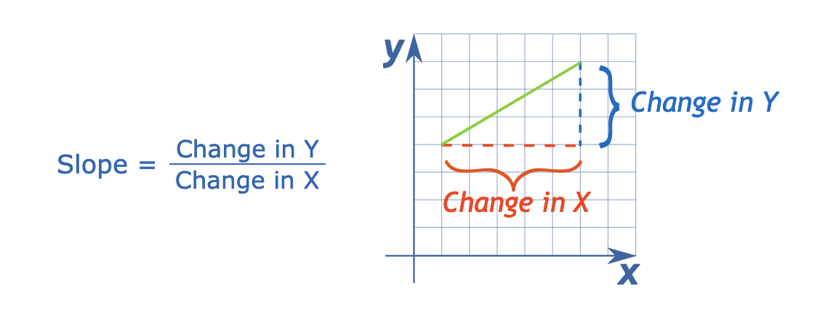
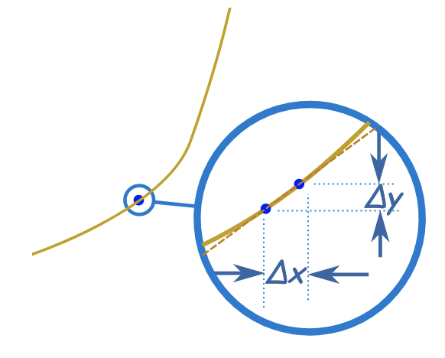
Automatized Machine Learning
Calculus
derivative of a function tell us how changes to the input will affect the output
Minimizing cost function
derivative of the cost function tells us, which way to change the inputs (weights & biases) to minimize the output (cost function error)

Slide 20
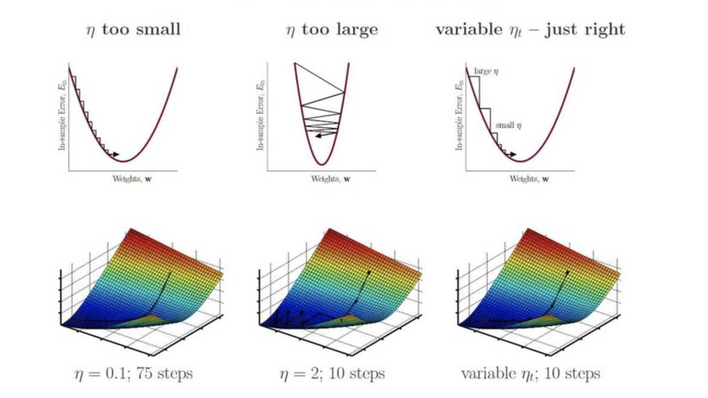
Automatized Machine Learning
Optimization algorithm - Gradient Descent
start with random w&b
in loop execute these step
calculate cost function
calculate derivative of cost function (chain rule & backpropagation)
modify w&b with negative derivative - to lower error, improve cost function
repeat until error is small enough
Gradient Descent
Gradient - gradient vector determines the direction of the biggest slope
Descent - incrementally adjusting to improve (gradient descent)
Notes:
(multivariable derivative - how does a small change in input affect/change the output)

Slide 21
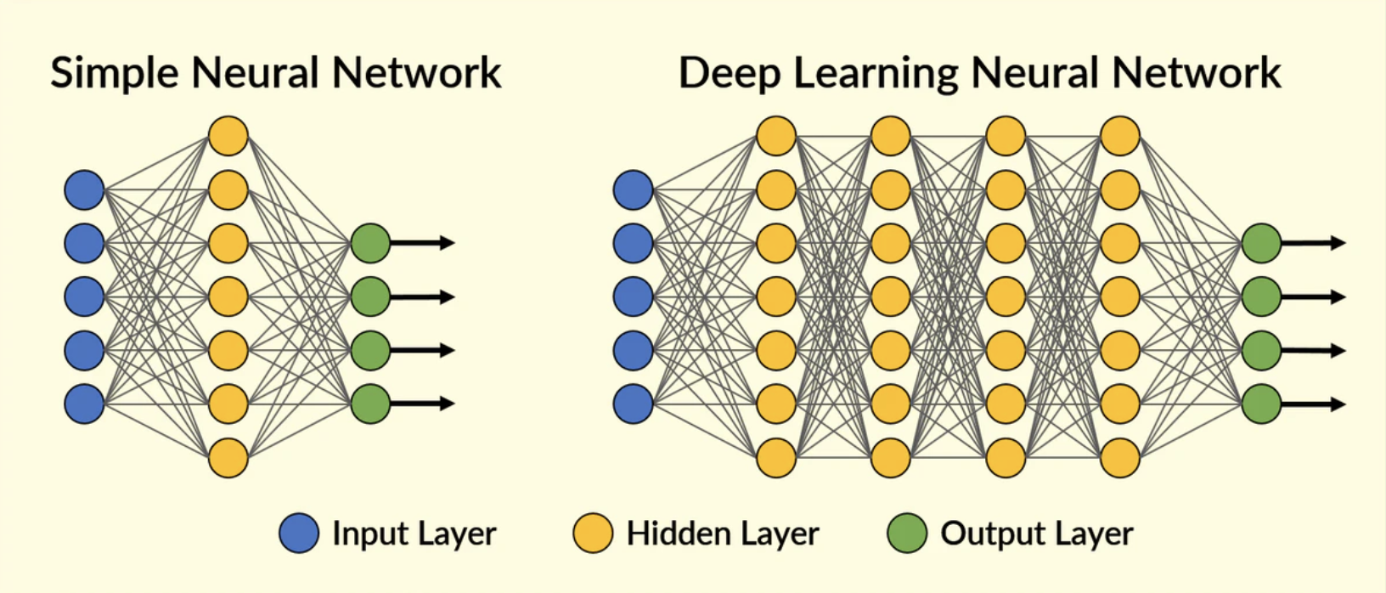
Deep Learning
- lots of hidden layers
- special techniques to avoid vanishing/exploding gradients
- heavy compute resource needs TPU/GPU
- lots of data
Notes:
https://www.kaggle.com/code/sahilambekar777/neural-net-pytorch-torch-nn-indepth-for-beginner/notebook

Slide 22
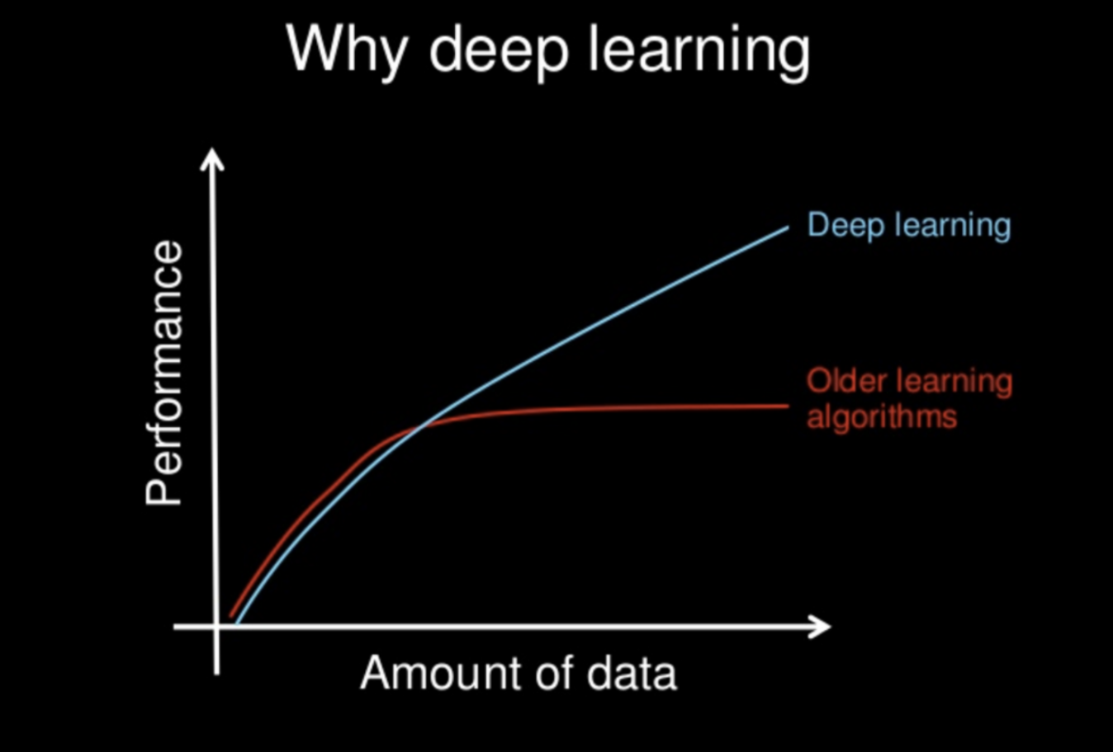
Why it took 50 years?
- large dataset
- cheap/efficient compute
Notes:
https://towardsdatascience.com/neural-networks-and-the-universal-approximation-theorem-8a389a33d30a

Slide 23
References
Youtube - Veritasium - Perceptron
Youtube - 3blue1brown - Machine Learning series
Neural Net playground - Strawberry vs Blueberry
Jalammar - Interactive activation function
Kaggle Notebook - Pytorch NN Tutorial
Towards Data Science article - NN, UAT

